Slide 1


Slide 2
Analyzing Personality through Social Media Profile Picture Choice
Anuj Khasgiwala

Slide 3
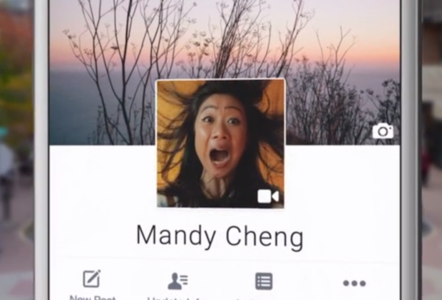
Motivation
Social media images portrays personality
Audience: Twitter users
Dataset: 66000 users
How: using tweets
Interpretation: analysis on aesthetic and facial features and control for demographic variation in image features and personality

Slide 4
Introduction
Freedom to speak or convey
Presentation depends on psychological traits and represent persona
Previous work on user traits(age, gender, occupation etc.)
Choice of Photos are type of behavior associated at least in part with personality expressed by five factor model
Digman Big Five – consisting of openness to experience, conscientiousness, extraversion, agreeableness and neuroticism

Slide 5
Relation between Personality and Picture
Extravert
Enjoy interacting
High group visibility
Energetic
Use picture involving other people or the once that express more positive emotions

